Slide 1

Stock Market Vs. Unemployment
The Correlation Coefficient
Michael Themistocleous, Robert Simeonoglou, Shilpa Gonella, Rusen Bicer

Slide 2
Table of Contents
Overview
Goals
Pre-Analysis Questions
Sources
Data Cleanup & Exploration
Results
Conclusion
Questions?

Slide 3

Overview:
Why did we choose this topic?
Real World Implications
Unemployment: all-time high
Stock Market: all-time high
Hypothesis:

Slide 4
Goals :
impact of the US economy vs Unemployment rates
Historical vs (most recent)
Stock in connection to the US unemployment rates
Levels: Country & States

Slide 5

Pre-Analysis Questions:
What stock data will we be using?
How will we find unemployment information?
How will we filter the information found to meet our needs?
What sort of analysis will we be performing?
What type of visual data will we use?

Slide 6

Sources
Dow Jones Industrial Average Stock Prices – Kaggle.com
US Bureau of Labor Statistics Unemployment Rate API – USA
US Bureau of Labor Statistics Unemployment Rate API – per State
Google Gmaps

Slide 7

Data Cleanup & Exploration

Slide 8
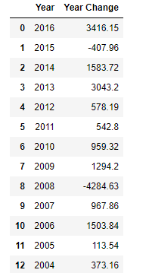
Dow Jones
Understanding the information
Given:
Weekly breakdown by Date and Value
Cleanup Process
Separate Month, Day, Year, and Value
Remove Day and sort years as descending values/concatenate
Take only the first value for every month
Find the Yearly Change and only choose January Values
Questions:
Why did we break it down by months and years?
Why was January the only month used?
Final Result:
(Before Index Drop)

Slide 9
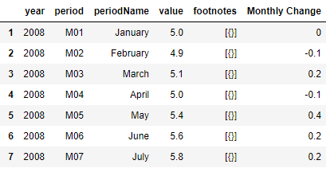
US Bureau of Labor Statistics Unemployment(Country-Wide)
Understanding the information
Given:
API consisting of:
Cleanup Process
Questions:
Final Result:

Slide 10
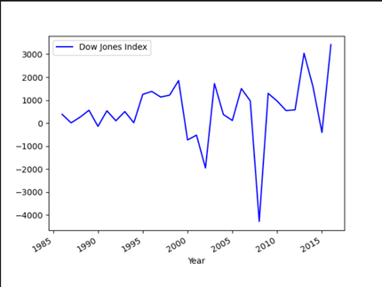
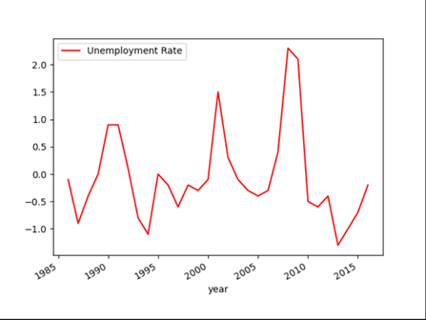
Dow Jones
Yearly Change Breakdown
Bureau of Labor Statistics
Index Price vs. Year
Unemployment Change Rate vs. Year

Slide 11
US Bureau of Labor Statistics Unemployment(State-Specific)

Slide 12
Finding the BEST correlation
Narrow our search
10 Year intervals based off data pulled

Slide 13
Results

Slide 14
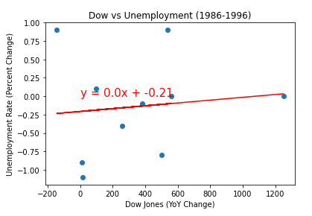
Dow vs. Unemployment (1986-1996)

Slide 15
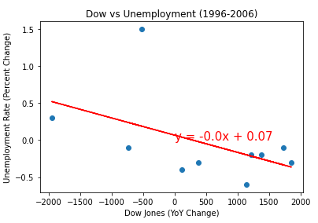
Dow vs. Unemployment (1996-2006)

Slide 16
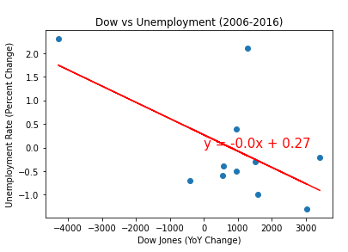
Dow vs. Unemployment (2006-2016)

Slide 17
Conclusion

Slide 18
Evaluation

Slide 19
Questions?

Slide 20
